Slide 1
Isaac Newton
1642-1726
Journey Through Genius Pp 161
Notes:
A Mind Unleashed:
Newton was born prematurely on Christmas day in 1642 to his widowed mother, and against all odds survived the harsh winter and live to the astonishing age of 84
When Newton’s mother remarried, the new husband was not wanting a three year old son, so Newton was left to live with his grandmother
Newton got a traditional education, studying the works of Latin and Greek scholars
He kept mostly to himself, and took to making things to occupy his time; he would make windmills that turned from a mouse running, he made sundials, attaching lanterns that were lit to a high flying kite during dark spring nights
Newton headed to college in Cambridge at age 19, he studied at Trinity College, an institution open for 400 years at this point, known for the King James translation of the Bible and the masterpiece of King’s College Chapel
Newton started his studies in Latin Literature and Aristotelian philosophy and quickly lost interest in his studies due to him seeing himself as brighter than his tutors and he had no one who cared whether he did or did not focus on his studies
While Newton’s peers also veered from their studies and turned to the pubs, Newton fell deep into reading and contemplation
Newton would walk around in such deep contemplation that he would forget to eat and sleep when faced with an especially intriguing problem -- reminiscent of Archimedes
Newton also held onto a lot of guilt, which was apparent by the book of sins that he kept
He often conducted experiments on the nature of light, color and vision; he once stared at the sun for an extended period of time and then recorded the spots that affective his vision for the days to come
Newton’s first time reading Elements he found most of the information trivial and self-evident
He not only read the works of the ancient Greeks, but also dove into the works of Descartes, he would read La Geometrie and would find himself stumped with some of the material, so he would begin the book again, he repeated this diving deeper and deeper with each read, teaching himself and looking deeply at it each time without a tutor
Newton had a hard time finding anyone who qualified to help him with his studies; that is, until Isaac Barrow, occupant of the prestigious Lucasian Chair of Mathematics
Through reading, and the guidance of what to read from Barrow, Newton went from a skilled scientific and mathematical scholar to being up to date with every discovery yet to be made in these disciplines
Having caught up with all the discoveries of the time, he was ready to stumble through uncharted territory
By 1664, Newton was promoted to a scholar at Trinity and was offered four year financial support to earn his Master’s degree
Newton was now free to study what interested him most, and spend his days in deep contemplation like he preferred, and use his amazing power of concentration
Newton’s explanation for how he solved his wonderful problems, “by thinking on them continuously” // and he really meant continuously, until he saw right through them at every angle
The next two years were the most productive of any thinker
Most of which was spent in Cambridge, and the rest spent in Woolsthorpe due to the university closing from the dreaded plague
Early in 1665 he discovered the generalized binomial theorem
He followed “method of fluxions” today known as differential calculus
And in 1666 he devised the inverse method of fluxions, today known as integral calculus
He then formulated his theory of colors
He follows with his embryonic theory of universal gravitation
The two plagued years 1665-1666 are known as Newton’s “wonderful years”, legend has it all his theories emerged in these two years, and his later years he spent refining and editing them, During these two years he was nothing more than an anonymous university student
Newton’s Binomial Theorem:
His first great mathematical discovery
Newton did not furnish a complete proof, so theorem is loosely used
The binomial theorem deals with the expansion of binomial equations to a high, nth degree
The Chinese mathematician, Yang Hui knew this secret in the 13th century, but was unknown in Europe until relatively recent times
Viete ran through binomial powers in his In Artem
And Pascal was the first to dive deep into binomial expansion and is credited with Pascal’s Triangle, an easy pattern to calculate the coefficients of a binomial expansion of high degrees
The link between Pascal’s triangle and Newton’s theorem is immediately recognizable
Newton wanted to be able to generate the coefficients more efficiently without running through the pattern of Pascal
Newton felt the need to come up with a general formula that works for rational, or negative powers as well
Newton’s first binomial expansion **insert expansion here Pp 167**
This looks unfamiliar and perplexing, but after a bit of explanation, it starts to look familiar, **insert explanation here Pp 168**
**insert examples from page 169, where n= 3, n= -3, n= ½**
Newton claimed: “extraction of roots are much shortened by this theorem”
**insert example showing the approximation of square root 7**
Newton’s binomial theorem tells us which fractions to use, and generates them in a mechanical fashion
In 1669 Newton wrote his first treatise on his fluxion ideas, and circulated it to a few mathematicians including Barrow
**insert Newton’s explanation on 171**
**insert the translation of Equations of an Infinite Number of Terms**
Using the binomial expansion and finding the area under a curve, Newton would use these tools to again try and approximate the value of pi

Slide 2
A Mind Unleashed

Slide 3
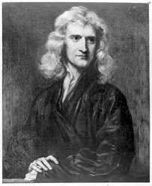
Early Life
Newton was born prematurely on Christmas day in 1642 to his widowed mother, and against all odds survived the harsh winter and live to the astonishing age of 84 When Newton’s mother remarried, the new husband was not wanting a three year old son, so Newton was left to live with his grandmother Newton got a traditional education, studying the works of Latin and Greek scholars He kept mostly to himself, and took to making things to occupy his time; he would make windmills that turned from a mouse running, he made sundials, attaching lanterns that were lit to a high flying kite during dark spring nights

Slide 4
Early Life cont.
Newton headed to college in Cambridge at age 19, he studied at Trinity College, an institution open for 400 years at this point, known for the King James translation of the Bible and the masterpiece of King’s College Chapel Newton started his studies in Latin Literature and Aristotelian philosophy and quickly lost interest in his studies due to him seeing himself as brighter than his tutors and he had no one who cared whether he did or did not focus on his studies While Newton’s peers veered from their studies and turned to the pubs, Newton fell deep into reading and contemplation Newton would walk around in such deep contemplation that he would forget to eat and sleep when faced with an especially intriguing problem -- reminiscent of Archimedes Newton also held onto a lot of guilt, which was apparent by the book of sins that he kept He often conducted experiments on the nature of light, color and vision; he once stared at the sun for an extended period of time and then recorded the spots that affective his vision for the days to come Newton’s first time reading Elements he found most of the information trivial and self-evident He not only read the works of the ancient Greeks, but also dove into the works of Descartes, he would read La Geometrie and would find himself stumped with some of the material, so he would begin the book again, he repeated this diving deeper and deeper with each read, teaching himself and looking deeply at it each time without a tutor

Slide 5
Early Life cont.
Newton had a hard time finding anyone who qualified to help him with his studies; that is, until Isaac Barrow, occupant of the prestigious Lucasian Chair of Mathematics
Through reading, and the guidance of what to read from Barrow, Newton went from a skilled scientific and mathematical scholar to being up to date with every discovery made in these disciplines
Having caught up with all the discoveries of the time, he was ready to stumble through uncharted territory By 1664, Newton was promoted to a scholar at Trinity and was offered four year financial support to earn his Master’s degree
Newton was now free to study what interested him most, and spend his days in deep contemplation like he preferred, and use his amazing power of concentration

Slide 6
Newton’s explanation for how he solved his problems,
“by thinking on them continuously”
He really meant continuously, until he saw through them at every angle.

Slide 7
A Few Contributions
The next two years were the most productive of any thinker Most of which was spent in Cambridge, and the rest spent in Woolsthorpe due to the university closing from the dreaded plague Early in 1665 he discovered the generalized binomial theorem He came upon his “method of fluxions” today known as differential calculus And in 1666 he devised the inverse method of fluxions, today known as integral calculus He then formulated his theory of colors He follows with his embryonic theory of universal gravitation The two plagued years 1665-1666 are known as Newton’s “wonderful years”, legend has it all his theories emerged in these two years, and his later years he spent refining and editing them, During these two years he was nothing more than an anonymous university student

Slide 8
Newton’s Binomial Theorem

Slide 9
Notes on Binomial Theorem
Newton’s first great mathematical contribution
Newton did not furnish a complete proof, so theorem is used loosely
The binomial theorem deals with the expansion of binomial equations to a high, nth degree The Chinese mathematician, Yang Hui knew this secret in the 13th century, but was unknown in Europe until relatively recent times Viete ran through binomial powers in his In Artem And Pascal was the first to dive deep into binomial expansion and is credited with Pascal’s Triangle, an easy pattern to calculate the coefficients of a binomial expansion of high degrees *Newton wanted an expansion that worked for rational or negative powers, and wanted to be able to do a quick expansion without running through the terms of Pascal’s triangle

Slide 10
Newton’s first binomial expression:

Slide 11
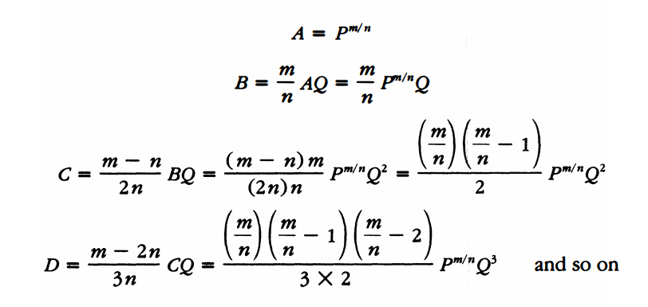
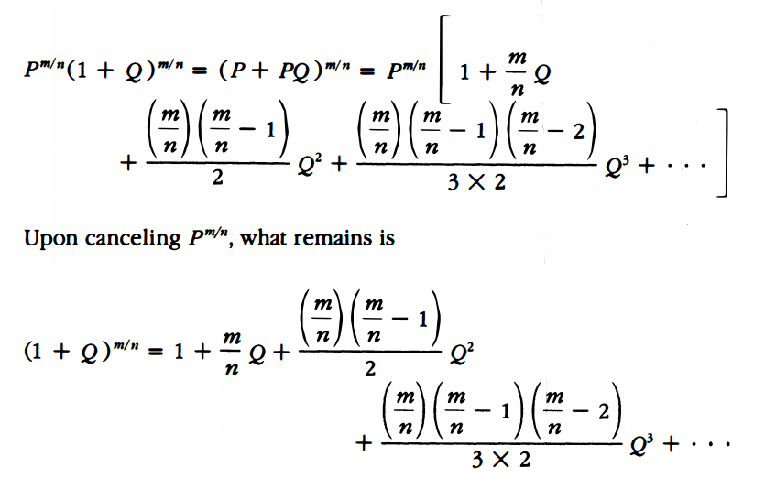
His original theorem looks a bit convoluted
After a bit of algebra, we can start to see a more familiar expression

Slide 12
Examples

Slide 13
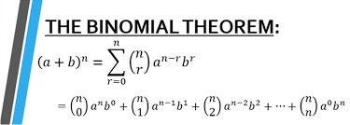
Modern Day Expression

Slide 14
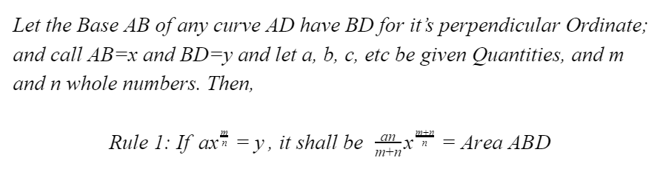
In 1669 Newton wrote his first treatise on his fluxion ideas, and circulated it to a few mathematicians including Barrow

Slide 15
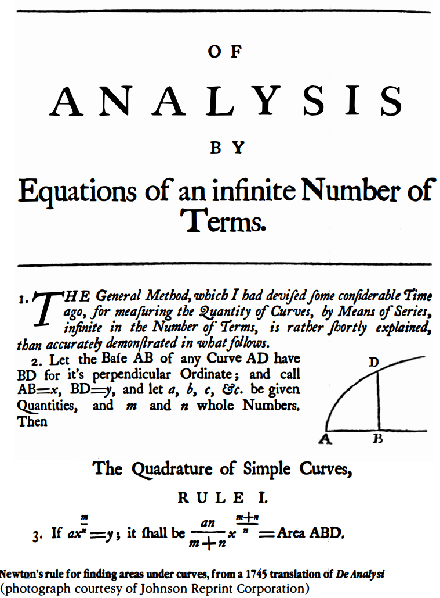
Using the binomial expansion and finding the area under a curve, Newton was a gain ready to try and approximate the value of 𝜋

